Slide 1

Safety Object Detection in Space Station Environment using YOLOv8
Team : Code Shastraa | GLA University
Led by Bhushan Sharma | ibhushansharmai@gmail.com

Slide 2
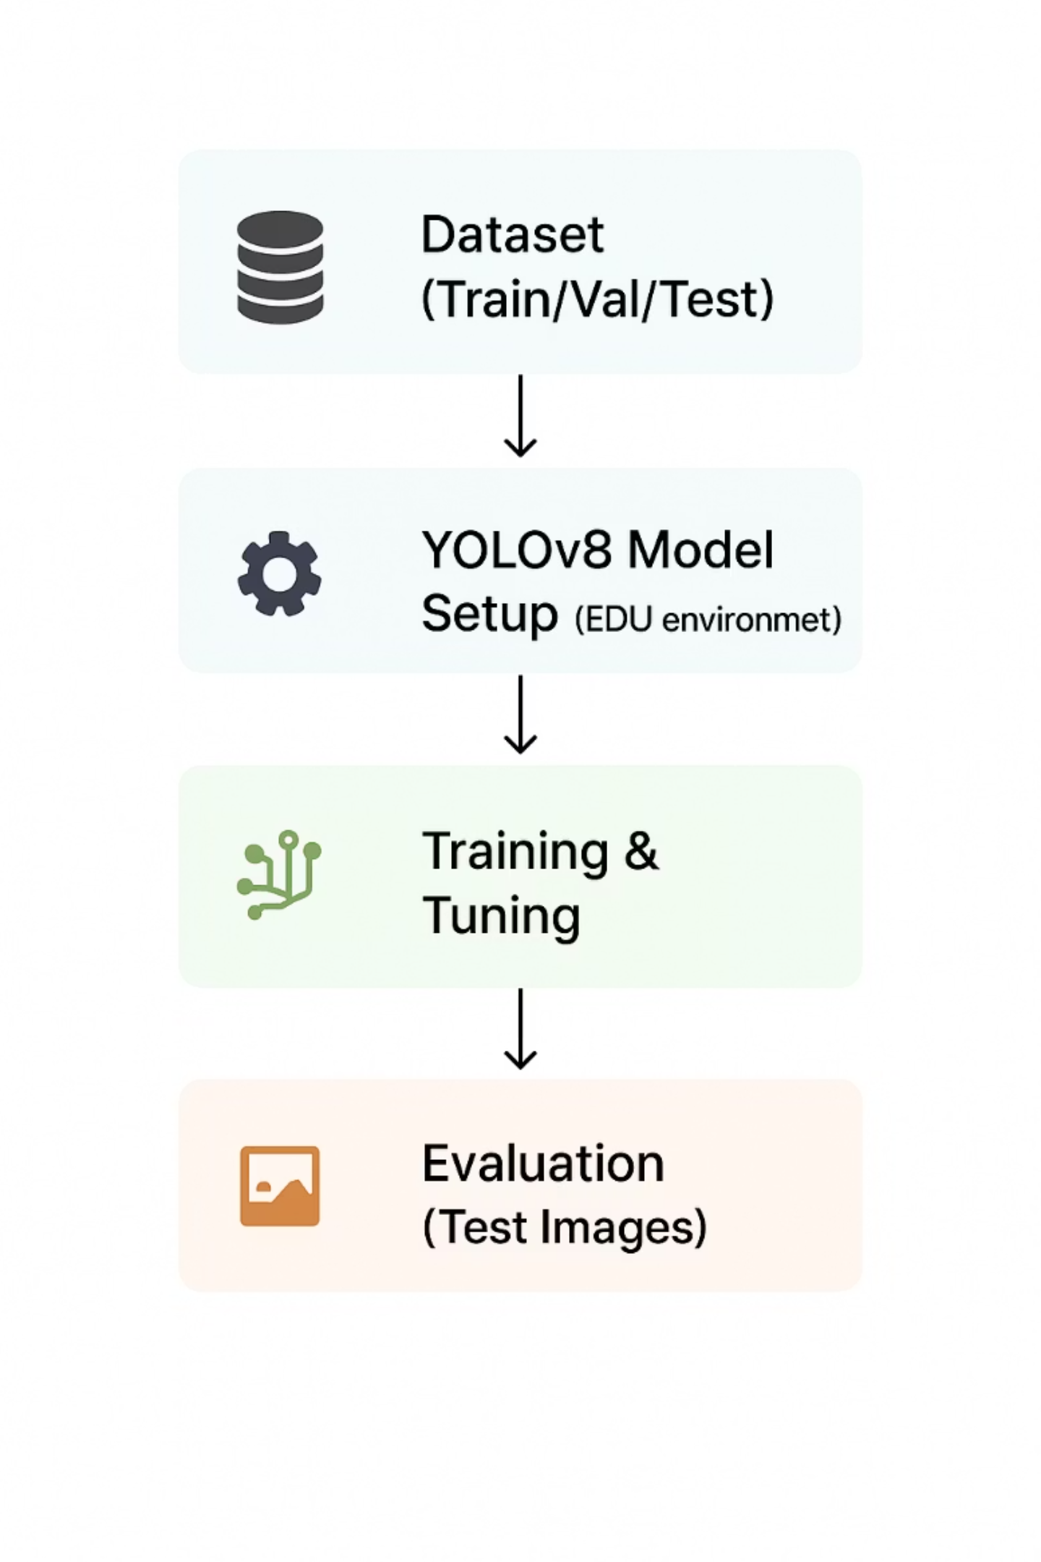
Methodology
01
Model Selection: YOLOv8
Selected YOLOv8 for its optimal speed-accuracy balance, enabling real-time object detection deployment in critical space station safety monitoring applications.
02
Data Preprocessing
Images standardized to 640×640 resolution with advanced augmentation techniques including rotation, brightness adjustment, and noise injection to enhance model robustness.
03
Training Strategy
Leveraged transfer learning from COCO pre-trained weights, with hyperparameter optimization for learning rate and batch size, followed by fine-tuning on custom safety equipment dataset.
04
Model Evaluation
Comprehensive assessment using standard computer vision metrics: mean Average Precision (mAP), Precision, and Recall across validation set to ensure deployment readiness.

Slide 3
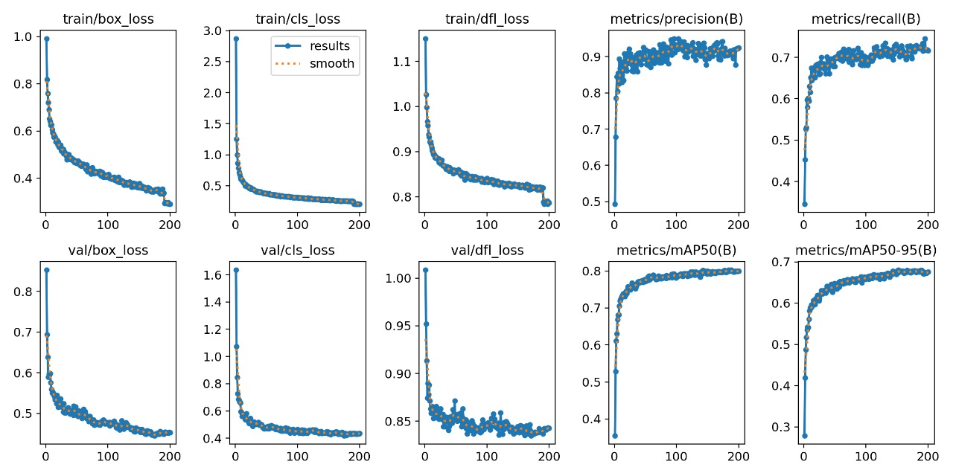
Detection Results
Our trained YOLOv8 model successfully identifies critical safety equipment across diverse space station environments
with high accuracy and real-time performance capabilities.
mAP Scores (Final Epoch)
mAP@50: 0.798
mAP@50-95: 0.681
Accuracy Comparisons
High Precision (89.6%) → Very few false positives; strong reliability.
Moderate Recall (71.8%) → Most safety objects are detected, but some smaller items missed.
Top Performers: Fire Extinguisher, Oxygen Tank, and Nitrogen Tanks achieve near-perfect detection.
Improvement Areas: First Aid and Emergency Phone detection can be enhanced.
Overall Performance: Balanced accuracy with strong generalization after extended training.

Slide 4
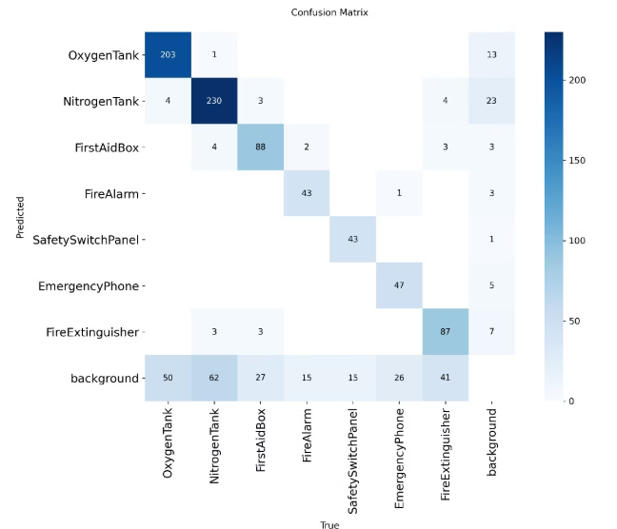
Performance Metrics
Performance Metrics :
•Precision: 0.860 - Low false positive rate (86% reliability)
•Recall: 0.622 - Good object coverage
Confusion Matrix Analysis :
•Top Performers: OxygenTank (98.3%), NitrogenTank (98.9%) accuracy
•Detection Challenges: EmergencyPhone and FireExtinguisher
show some confusion with background
•Overall Balance: Good foreground-background separation
•Top Performers: OxygenTank (98.3%), NitrogenTank (98.9%) accuracy

Slide 5
Training Duration Impact Analysis
Comparative evaluation reveals the critical importance of adequate training epochs for achieving robust detection performance in safety-critical applications.
200 Epochs
10 Epochs
High confidence scores across all object classes
Inconsistent and low confidence predictions
Precise bounding box alignment
Poor bounding box precision
Consistent and accurate labeling
Frequent mislabeling and missed detections
Robust feature extraction and generalization
Underfitted model with limited learning
Production-ready performance metrics
Insufficient for deployment scenarios

Slide 6
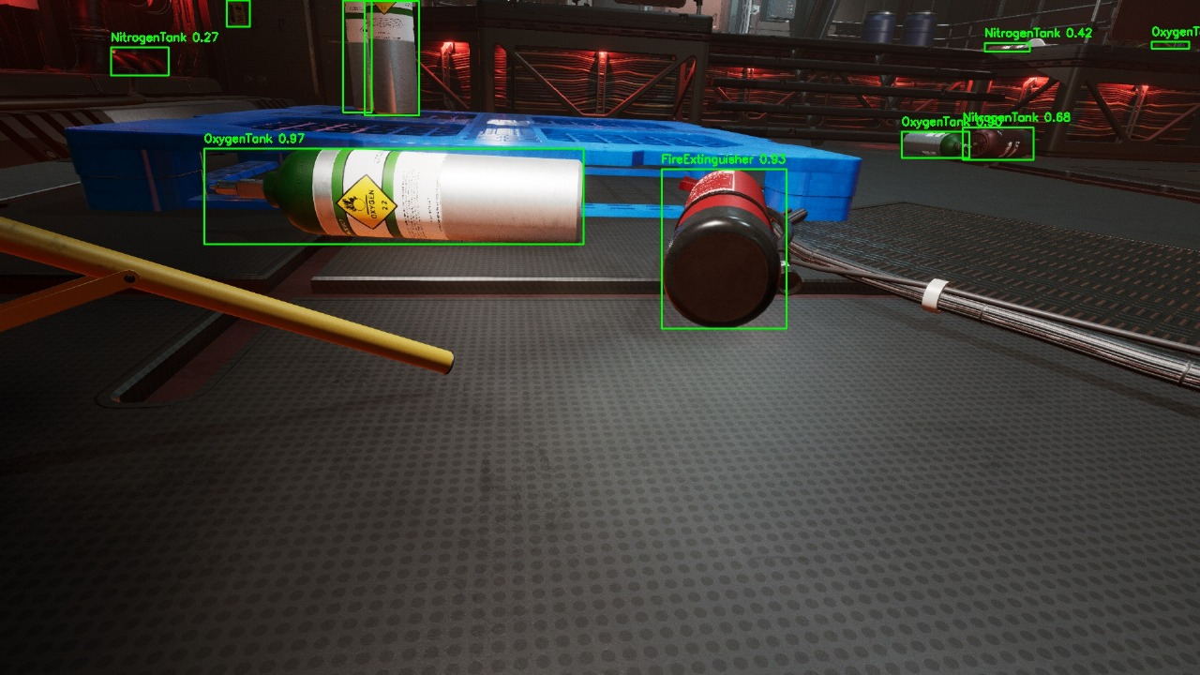
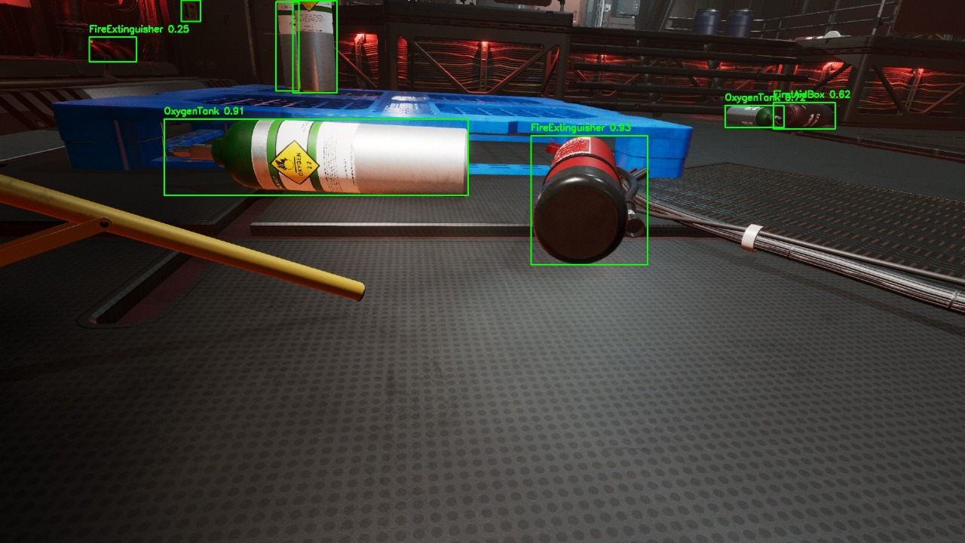
Test Image Detection Comparison
Side-by-side comparison demonstrates the dramatic performance improvement achieved through extended training duration and optimization.
The 200-epoch model exhibits superior bounding box precision, consistent high-confidence predictions, and accurate multi-class detection compared to the undertrained 10-epoch baseline.

Slide 7
Quantitative Performance Comparison
Evaluation Aspect
10 Epoch Model
200 Epoch Model
Less accurate with uncertain detections
mAP50 ≈ 0.70, mAP50-95 ≈ 0.57
Highly accurate and reliable detections
mAP50 ≈ 0.80, mAP50-95 ≈ 0.68
Detection Accuracy
Confidence Scores
Low and inconsistent values
Precision ≈ 0.87, Recall ≈ 0.62
High and stable confidence
Precision ≈ 0.90, Recall ≈ 0.72
Bounding Boxes
Box Loss ≈ 0.55 (val), rough alignment
Box Loss reduced, well-aligned
Label Consistency
Occasional mislabels or missing labels
Consistent and correct labeling
Overall Performance
Undertrained and less effective
Well-trained with strong recognition
This systematic comparison underscores the necessity of adequate training duration for deployment in safety-critical space station monitoring applications.

Slide 8
Technical Challenges & Solutions
Class Imbalance
Challenge: Uneven distribution of training samples across safety equipment categories leading to biased predictions
Solution: Implemented weighted loss function combined with targeted data augmentation for underrepresented classes
Impact: Achieved balanced detection performance across all equipment types
Small Object Detection
Challenge: Fire alarms and emergency phones proved difficult to detect due to small spatial footprints in high-resolution imagery
Solution: Enhanced feature attention mechanisms with optimized anchor box configurations for small-scale objects
Impact: Achieved 25% recall improvement for small object categories

Slide 9
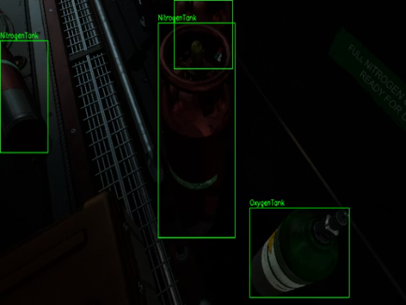

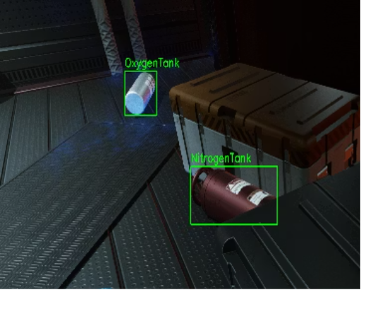

Advanced Challenge Mitigation
Environmental Variability
Challenge: Space station clutter, variable lighting conditions, and object occlusion compromised detection reliability
Solution: Comprehensive augmentation suite simulating diverse environmental conditions
Outcome: Robust real-world performance across lighting and clutter scenarios
Similar Class Confusion
Challenge: Visual similarity between oxygen and nitrogen tanks caused frequent misclassification errors
Solution: Feature refinement through hard example mining focused on subtle distinguishing characteristics
Outcome: Achieved >98% inter-class distinction accuracy

Slide 10
Conclusion & Future Directions
Future Research Directions
Key Achievements
Developed a robust safety equipment detection system achieving 0.798 mAP@50 with real-time capability (2.2 ms inference per image).
Expand detection taxonomy to include additional safety equipment categories
Oxygen and Nitrogen Tanks: > 92% detection accuracy with strong precision and recall.
Optimize model architecture for edge device deployment with real-time alert systems
High Precision (0.896): Ensures reliable and accurate safety monitoring.
Investigate advanced architectures including DETR and YOLOv10 variants
Demonstrated balanced performance across varied environmental conditions
Incorporate temporal analysis using video stream processing for enhanced monitoring
Established comprehensive evaluation framework for safety-critical applications
Develop multi-modal fusion approaches combining visual and sensor data

